Slide 1
MORDM using Rhodium The lake problem workflow
Antonia Hadjimichael
Reed Group Meeting
July 31, 2019
Notes:
Overarching Theme of Research – 5 min
Lake Problem work so far – 10 min
Red River work so far – 10 min
Papers/studies (<= 10 min)
Lake study
Policy diagnostic on Red River
Expand information in policies and explore robustness to climate change
Back-up slides anticipating questions

Slide 2
Disclaimer and additional info
This training is meant to guide you on the what and why of MORDM using the lake problem. There is a lot of material others have written which I will be reusing because there is no point in reinventing the wheel:
Julie’s GH repository for the system:
https://github.com/julianneq/Lake_Problem_DPS
Julie’s paper:
https://www.sciencedirect.com/science/article/pii/S1364815216302250
Dave Hadka’s Rhodium example scripts (that I modified):
https://github.com/Project-Platypus/Rhodium/tree/master/examples/Basic
A lot of these slides have also been prepared by others (Julie Quinn, Jon Herman, Tori Ward, Dave Gold)

Slide 3
Learning outcomes of this training
Use Rhodium for:
Optimization to generate alternatives
Exploratory modeling for multiple states of the world
Assess the robustness of candidate solutions
Sensitivity analysis to identify key factors for failure
Highlight the importance of these steps in the context of MORDM
Demonstrate the value of Direct Policy Search (DPS)
Investigate the challenges posed by nonlinear tipping points

Slide 4
Many-Objective Robust Decision Making (MORDM)
Exploratory modeling framework
Investigate the response of alternative management plans to a wide range of deeply uncertain states of the world (SOWs)

Slide 5
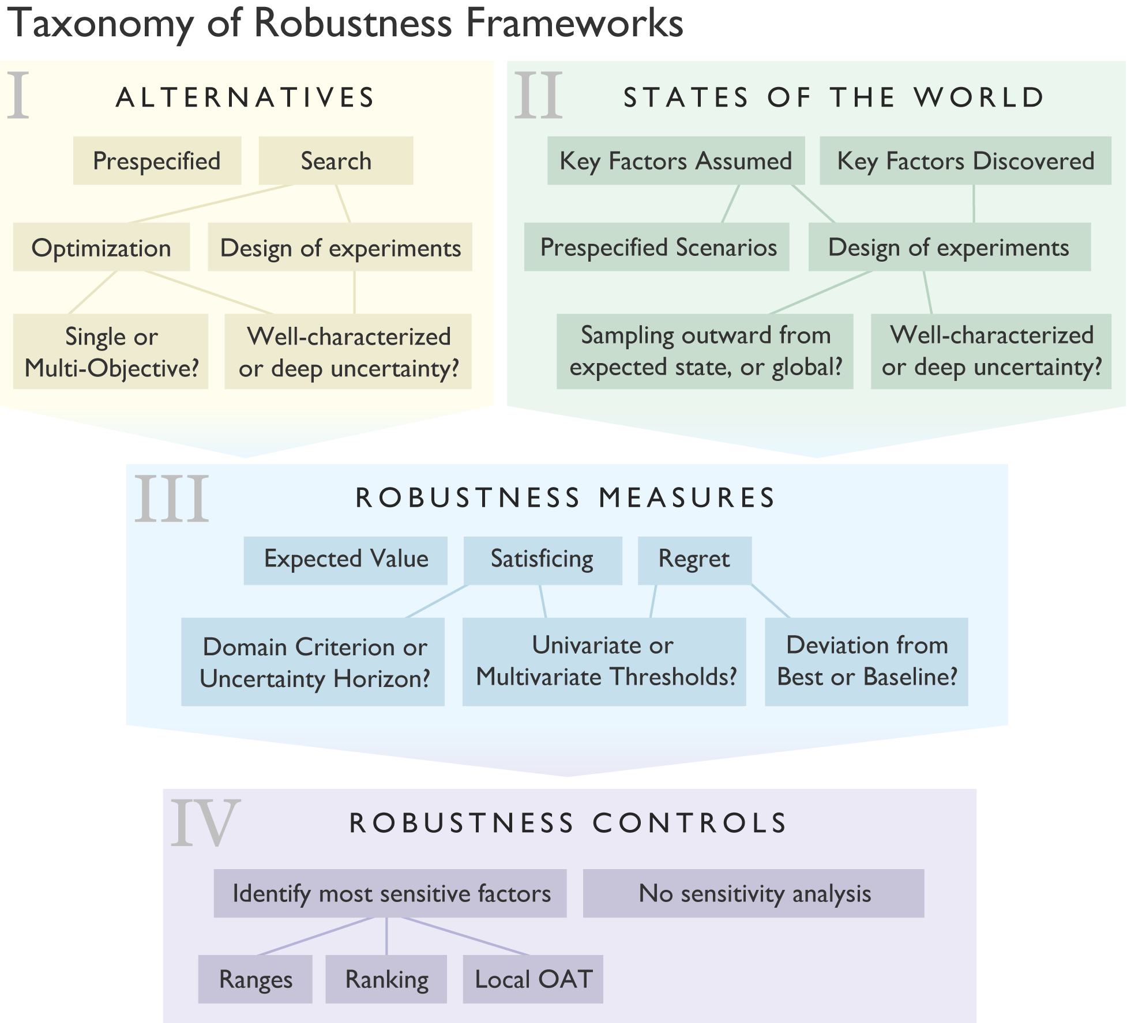
Taxonomy of robustness frameworks
Herman et al. (2015)
https://doi.org/10.1061/(ASCE)WR.1943-5452.0000509

Slide 6







Rhodium Robust Decision Making
Python library capable of:
Multi-objective Optimization
Exploratory Modeling
Scenario Discovery
Global Sensitivity Analysis
Dave Hadka,
Developer
Acts as the “glue” between your model and analysis codes
Connects to models in C, C++, Fortran, Excel, R, Python
Fortran

Slide 7
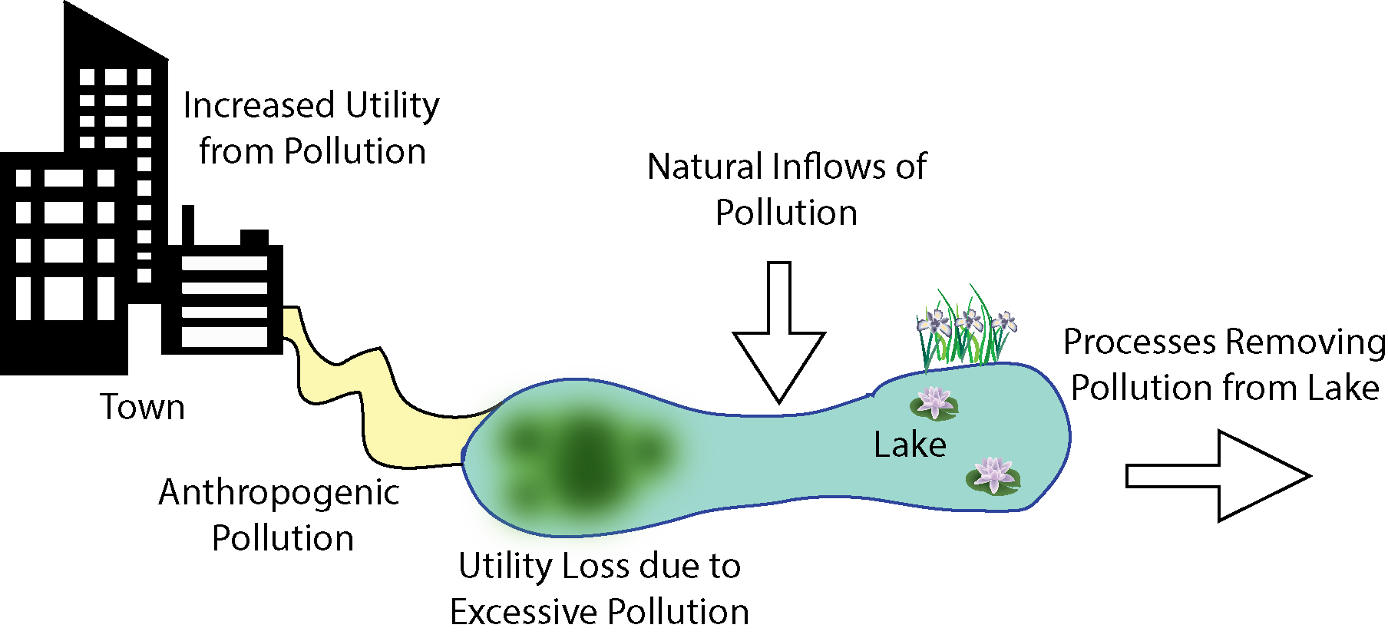
The Shallow Lake Problem
P Recycled in the Lake
Environmental and Economic Objectives are in Direct Conflict
Slide credit: Tori Ward
Notes:
Notes on Lake Problem choice: It is one of the most popular tipping point benchmark problems to emerge from environmental decision-making literature.
It has a rich conceptualization that allows for exploration of challenging management and mathematical traits with relatively modest computational demands.

Slide 8
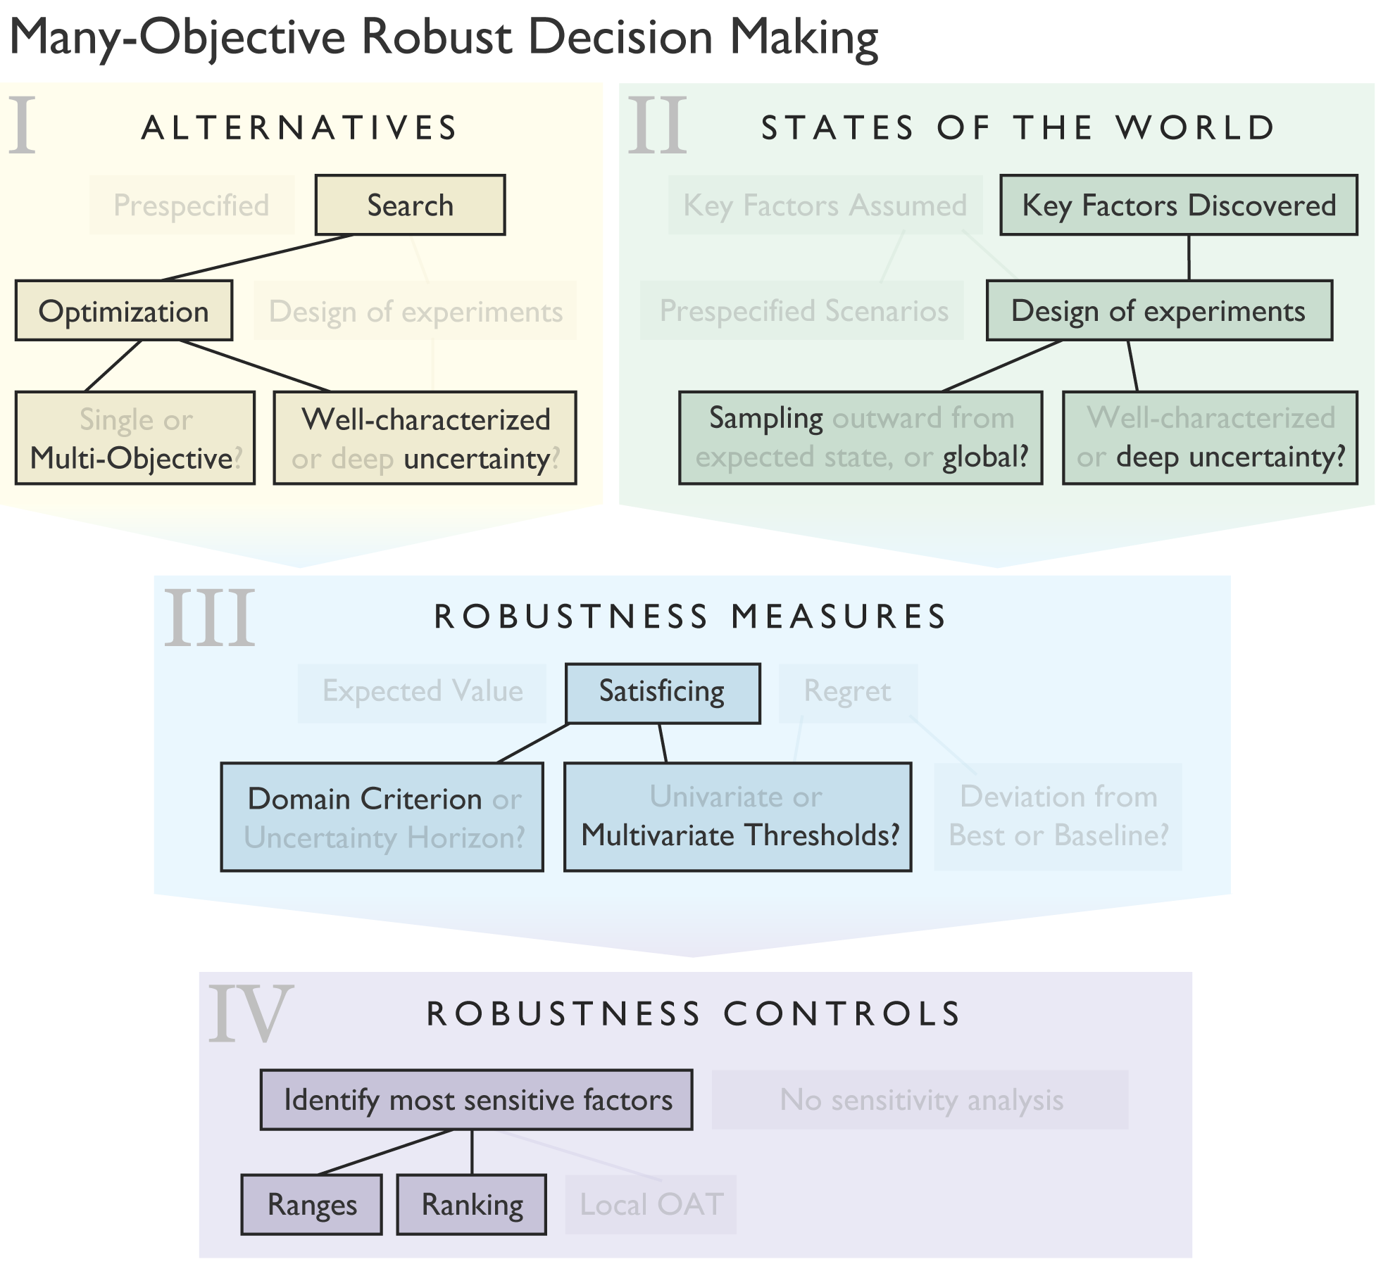
MORDM using Rhodium The lake problem workflow

Slide 9
MORDM using Rhodium The lake problem workflow
Difficult to identify effective policies:
High dimensional decision space for candidate actions (one action per timestep)
Weak system response to decisions at the end of the study period
Non-linear threshold
Use of Direct Policy Search (DPS):
Closed loop control
Map system states to decisions
Result in a policy, not a sequence of actions

Slide 10
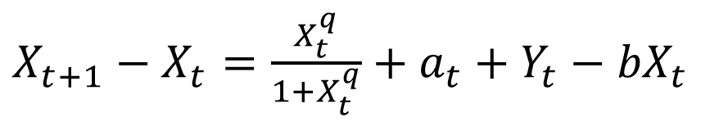
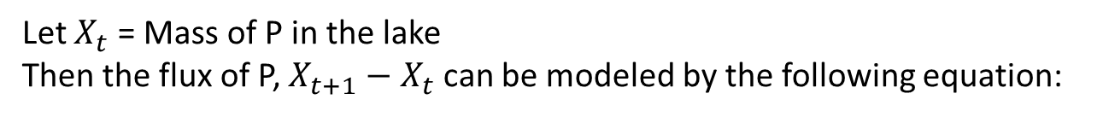
Model of lake dynamics
Let $X_{t}$ = Mass of P in the lake
Then the flux of P, $X_{t+1}−X_{t}$ can be modeled by the following equation:
$X_{t+1}−X_{t}=\frac{X_{t}^{q}}{1+X_{t}^{q}}+a_{t}+Y_{t}−{bX}_{t}$
10
Notes:
Discuss reversible, hysteretic, and irreversible lakes and mention that this study focused on irreversible lakes.

Slide 11
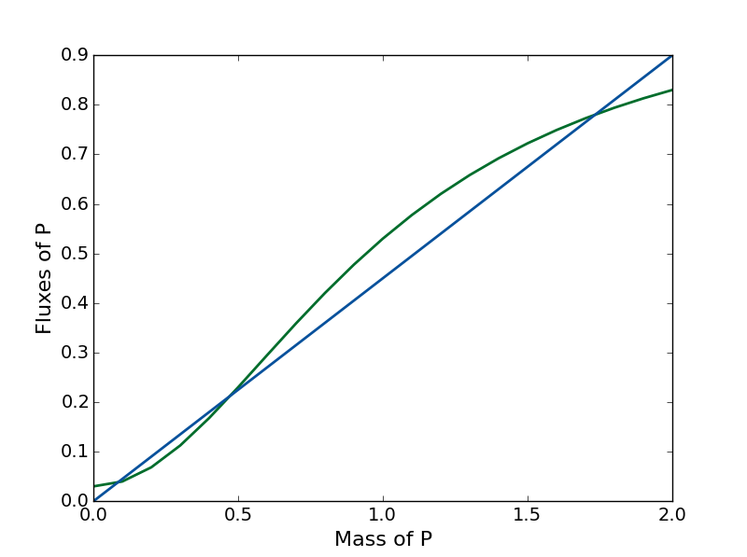
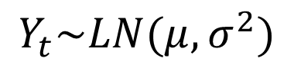
Model of lake dynamics
Fluxes of P
Recycled P
Anthropogenic P Inputs
Natural P Inputs
P Sinks
$X_{t+1}−X_{t}=\frac{X_{t}^{q}}{1+X_{t}^{q}}+a_{t}+Y_{t}−{bX}_{t}$
$$Y_{t}\sim LN(μ,σ^{2})$$
11
Notes:
Discuss reversible, hysteretic, and irreversible lakes and mention that this study focused on irreversible lakes.

Slide 12
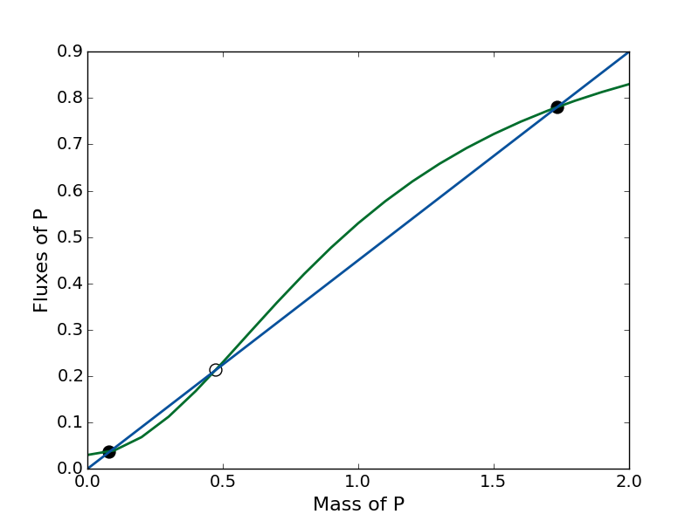
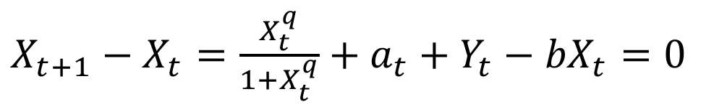
Model of lake dynamics
Fluxes of P
Inputs
Outputs
$X_{t+1}−X_{t}=\frac{X_{t}^{q}}{1+X_{t}^{q}}+a_{t}+Y_{t}−{bX}_{t}=0$
Equilibrium
12
Notes:
Discuss reversible, hysteretic, and irreversible lakes and mention that this study focused on irreversible lakes.

Slide 13
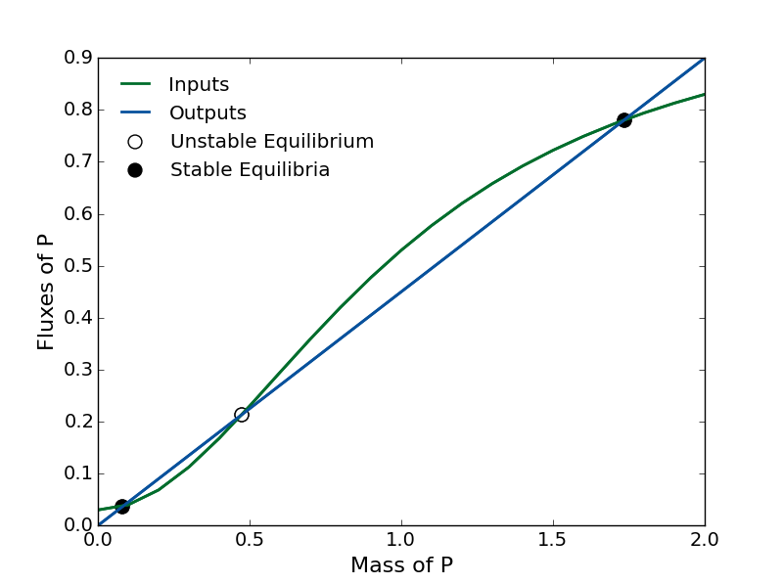
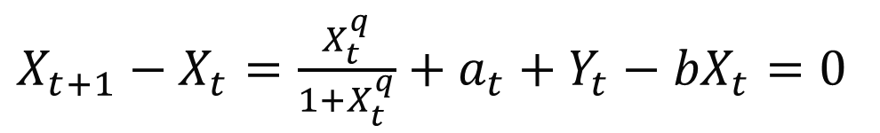
$X_{t+1}−X_{t}=\frac{X_{t}^{q}}{1+X_{t}^{q}}+a_{t}+Y_{t}−{bX}_{t}=0$

Slide 14
$X_{t+1}−X_{t}=\frac{X_{t}^{q}}{1+X_{t}^{q}}+a_{t}+Y_{t}−{bX}_{t}=0$
Direction of Attraction

Slide 15
$X_{t+1}−X_{t}=\frac{X_{t}^{q}}{1+X_{t}^{q}}+a_{t}+Y_{t}−{bX}_{t}=0$
Direction of Attraction
Unhealthy, Eutrophic Equilibrium
Healthy, Oligotrophic Equilibrium

Slide 16
$X_{t+1}−X_{t}=\frac{X_{t}^{q}}{1+X_{t}^{q}}+a_{t}+Y_{t}−{bX}_{t}=0$
Direction of Attraction
Unhealthy, Eutrophic Equilibrium
Tipping Point
Healthy, Oligotrophic Equilibrium

Slide 17
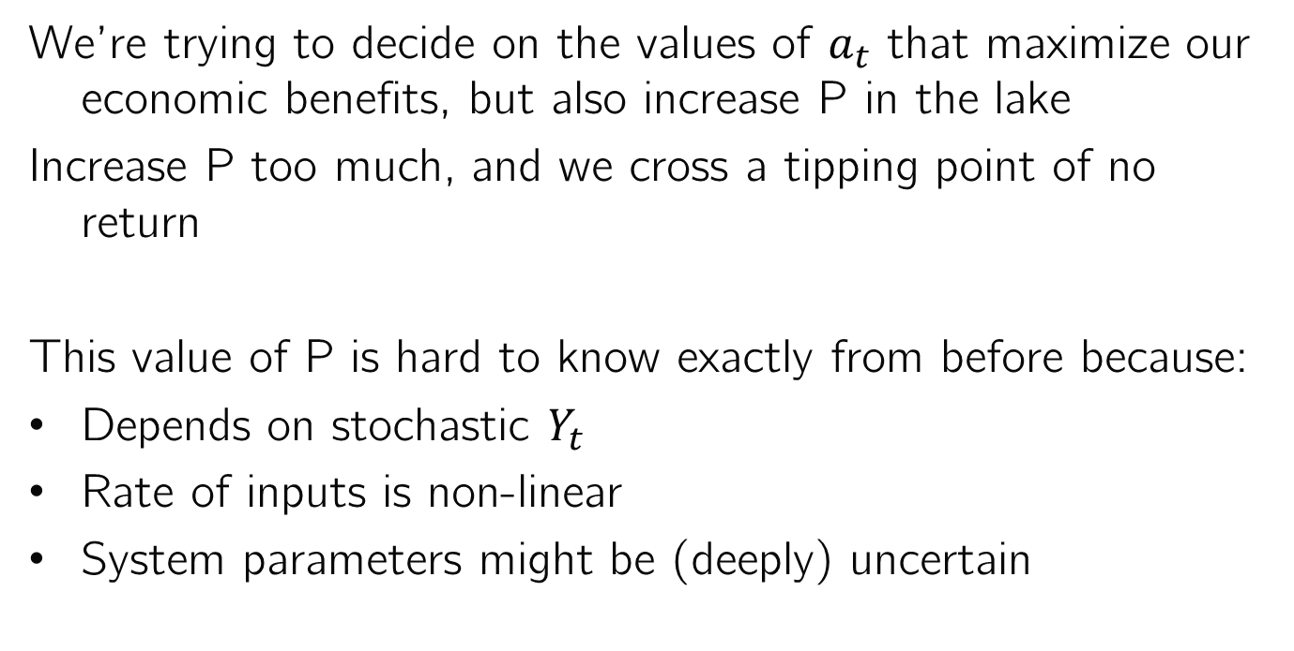
Why is this important?
We’re trying to decide on the values of $a_{t}$ that maximize our economic benefits, but also increase P in the lake
Increase P too much, and we cross a tipping point of no return
This value of P is hard to know exactly from before because:
Depends on stochastic $Y_{t}$
Rate of inputs is non-linear
System parameters might be (deeply) uncertain

Slide 18





Multi-objective formulation of the Lake Problem
Objective 1:
Objective 2:
Maximize Expected Economic Benefits
Minimize Maximum P Concentration
Objective 3:
Objective 4:
Maximize Inertia (Measure of Stability)
Maximize Reliability (Fraction of Years Below Threshold)
Notes:
Describe each objective and how it is calculated. The lake problem hopes to maximize economic benefit while minimizing Phosphorus concentrations in the lake by deciding how much to pollute in each time step. Economic Benefit is the expected benefit. Phosphorus in the lake is a minimization of the maximum expected phosphorus in each time step. This formulation involves one hundred time steps. In each time step, the town may alter its Phosphorus load. There is an inertia objective to minimize the number of time steps in which the town decreases its phosphorus load by more than 20% of the maximum possible range. Reliability is calculated as the total number of times the lake does not flip over all time steps and states of the world. In this formulation, the threshold is known, making the problem substantially easier than it could be.
There was a reliability constraint that reliability must remain above 85%. This is substantially less risk averse than many real-world managers would be.
Mention all of the analogous environmental threshold problems. Also mention that these are just one possible abstraction of values related to an uncertain threshold.

Slide 19
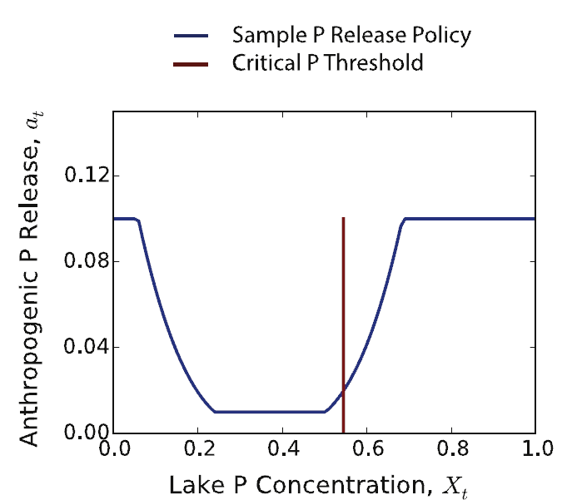
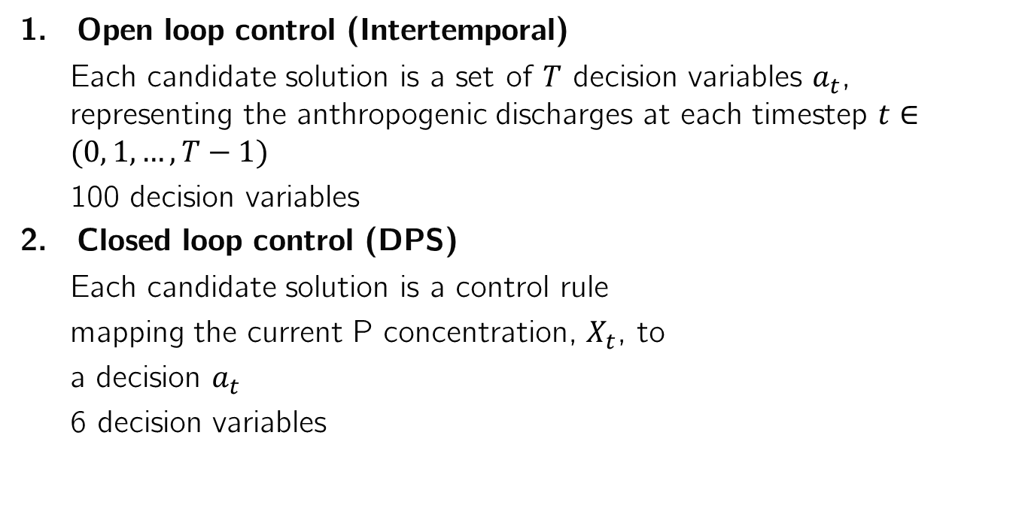
Solution strategies
Open loop control (Intertemporal)
Each candidate solution is a set of $T$ decision variables $a_{t}$, representing the anthropogenic discharges at each timestep $t∈(0, 1, …, T−1)$
100 decision variables
Closed loop control (DPS)
Each candidate solution is a control rule
mapping the current P concentration, $X_{t}$, to
a decision $a_{t}$
6 decision variables
This figure can be replicated by running this script

Slide 20
Model formulation in Rhodium General template for creating a Rhodium model
from rhodium import *
def model_name(array_of_levers, array_of_model_parameters):
return(array_of_model_responses)
model = Model(model_name)
model.parameters = [Parameter(“parameter_name1"),
Parameter(“parameter_name2")]
model.responses = [Response(“system_objective1”, Response.MINIMIZE),
Response(“system_objective2”, Response.MAXIMIZE),
Response(“system_objective3”, Response.INFO)]
model.constraints = [Constraint(" system_objective3 >= 0.8")]
model.levers = [RealLever("array_of_levers", 0.0, 0.1, length=100)]
model.uncertainties = [UniformUncertainty("parameter_name1", 0.0, 5.00),
UniformUncertainty("parameter_name2", 2.0, 8.5)]
output = optimize(model, "NSGAII", 10000)
system model as a function
parameters of interest
model responses or outputs
constraints that must be satisfied
parameters we have control over (levers)
parameters representing exogeneous uncertainties

Slide 21
Model formulation in Rhodium 1. Open loop control (Intertemporal)
import math
import numpy as np
import matplotlib as mpl
import matplotlib.pyplot as plt
from scipy.optimize import brentq as root
from rhodium import *
# Construct the lake problem
def lake_problem(pollution_limit,
b = 0.42, # decay rate for P in lake (0.42 = irreversible)
q = 2.0, # recycling exponent
mean = 0.02, # mean of natural inflows
stdev = 0.001, # standard deviation of natural inflows
alpha = 0.4, # utility from pollution
delta = 0.98, # future utility discount rate
nsamples = 100): # monte carlo sampling of natural inflows
#Body of function
return (max_P, utility, inertia, reliability)
Script can be found here

Slide 22
Model formulation in Rhodium 1. Open loop control (Intertemporal)
model = Model(lake_problem)
model.parameters = [Parameter("pollution_limit"),
Parameter("b"),
Parameter("q"),
Parameter("mean"),
Parameter("stdev"),
Parameter("delta")]
model.responses = [Response("max_P", Response.MINIMIZE),
Response("utility", Response.MAXIMIZE),
Response("inertia", Response.MAXIMIZE),
Response("reliability", Response.MAXIMIZE)]
model.constraints = [Constraint("reliability >= 0.95")]
model.levers = [RealLever("pollution_limit", 0.0, 0.1, length=100)]
model.uncertainties = [UniformUncertainty("b", 0.1, 0.45),
UniformUncertainty("q", 2.0, 4.5),
UniformUncertainty("mean", 0.01, 0.05),
UniformUncertainty("stdev", 0.001, 0.005),
UniformUncertainty("delta", 0.93, 0.99)]
Define all parameters to the model that we will be studying
Define the model outputs
Define any constraints (can reference any parameter or response)
Some parameters are levers that we control via our policy
Some parameters are exogenous uncertainties
Script can be found here

Slide 23
Model formulation in Rhodium 1. Open loop control (Intertemporal)
We can use cache to store intermediate results and also reuse them later without having to rerun the optimization
setup_cache(file="example.cache")
output = cache("output", lambda: optimize(model, "NSGAII", 10000))
Without using the cache, execute with simply:
output = optimize(model, "NSGAII", 10000)
To store outputs:
output.save("output.csv")
To store only objectives:
output.as_dataframe()[list(model.responses.keys())].to_csv('output_objectives.csv')
To load:
output = load('output.csv')[1]
Script can be found here

Slide 24
Model formulation in Rhodium 2. Closed loop control (DPS)
import math
import numpy as np
import matplotlib as mpl
import matplotlib.pyplot as plt
from scipy.optimize import brentq as root
from rhodium import *
# Construct the lake problem
def lake_problem_dps(policy, # the DPS policy
b = 0.42, # decay rate for P in lake (0.42 = irreversible)
q = 2.0, # recycling exponent
mean = 0.02, # mean of natural inflows
stdev = 0.001, # standard deviation of natural inflows
alpha = 0.4, # utility from pollution
delta = 0.98, # future utility discount rate
nsamples = 100, # monte carlo sampling of natural inflows
steps = 100): # the number of time steps (e.g., days)
#Body of function
return (max_P, utility, inertia, reliability)
Script can be found here

Slide 25
Model formulation in Rhodium 2. Closed loop control (DPS)
dps_model = Model(lake_problem_dps)
dps_model.parameters = [Parameter("policy"),
Parameter("b"),
Parameter("q"),
Parameter("mean"),
Parameter("stdev"),
Parameter("delta")]
dps_model.responses = [Response("max_P", Response.MINIMIZE),
Response("utility", Response.MAXIMIZE),
Response("inertia", Response.MAXIMIZE),
Response("reliability", Response.MAXIMIZE)]
dps_model.constraints = [Constraint("reliability >= 0.95")]
dps_model.levers = [CubicDPSLever("policy", length=3)]
dps_model.uncertainties = [UniformUncertainty("b", 0.1, 0.45),
UniformUncertainty("q", 2.0, 4.5),
UniformUncertainty("mean", 0.01, 0.05),
UniformUncertainty("stdev", 0.001, 0.005),
UniformUncertainty("delta", 0.93, 0.99)]
Define all parameters to the model that we will be studying
Define the model outputs
Define any constraints (can reference any parameter or response)
This strategy uses a DPS function as a lever
Some parameters are exogenous uncertainties
Script can be found here

Slide 26
Model formulation in Rhodium 2. Closed loop control (DPS)
We can use cache to store intermediate results and also reuse them later without having to rerun the optimization
setup_cache(file="dps_example.cache")
dps_output = cache("dps_output", lambda: optimize(model, "NSGAII", 10000))
Without using the cache, execute with simply:
dps_output = optimize(model, "NSGAII", 10000)
To store outputs:
dps_output.save("dps_output.csv")
To store only objectives:
dps_output.as_dataframe()[list(dps_model.responses.keys())].to_csv('dps_output_objectives.csv')
Script can be found here

Slide 27
Exploring tradeoffs with Rhodium
To explore the two sets of candidate strategies using the tools provided by Rhodium, we need to merge them into a single dataset. We can do so by adding a key to each solution identified by each strategy:
for i in range(len(output)):
output[i]['strategy']=1
dps_output[i]['strategy']=0
merged = DataSet(output+dps_output)

Slide 28
Exploring tradeoffs with Rhodium
We can visualize the two sets with J3.
We’d need to import it first with: from j3 import J3
J3(merged.as_dataframe(list(model.responses.keys())+['strategy']))

Slide 29
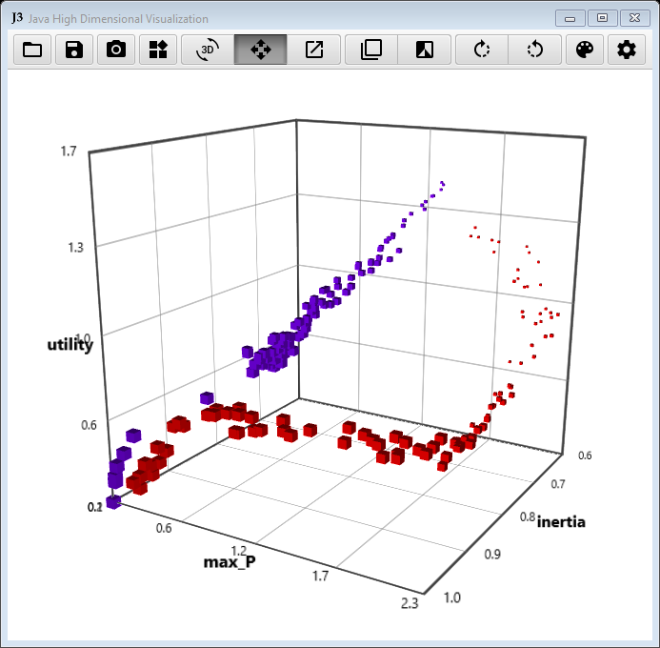
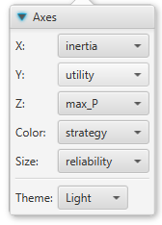
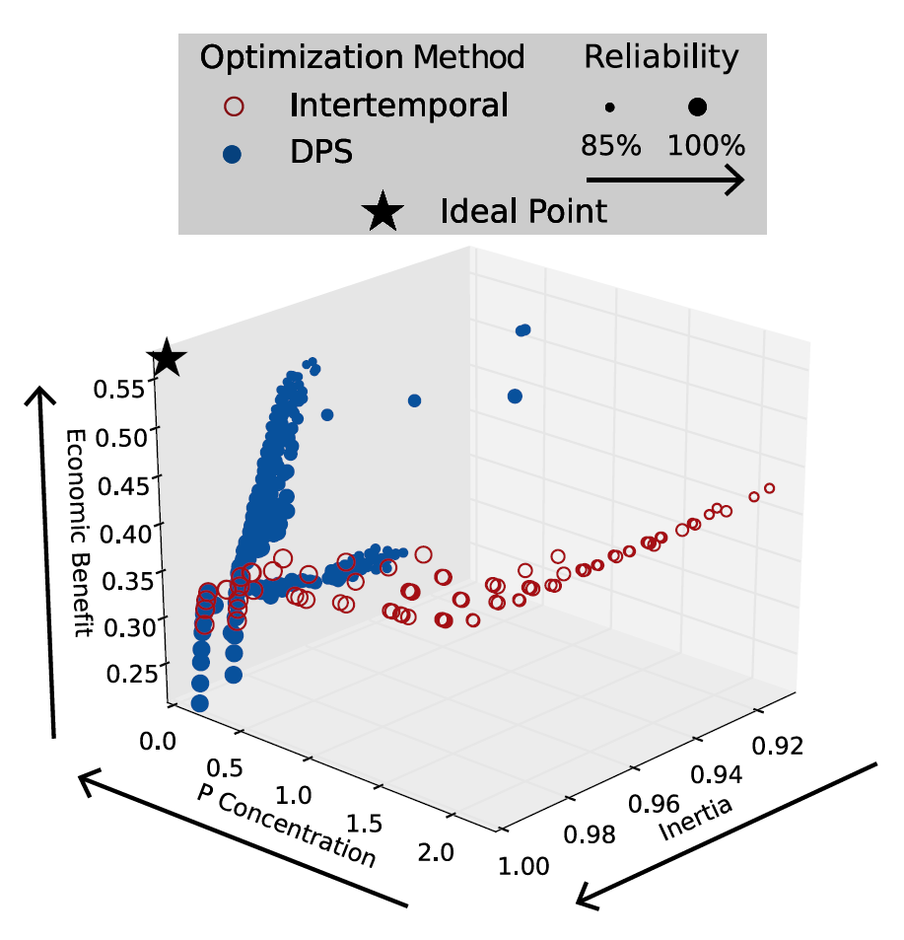
Exploring tradeoffs with Rhodium
Intertemporal
DPS

Slide 30
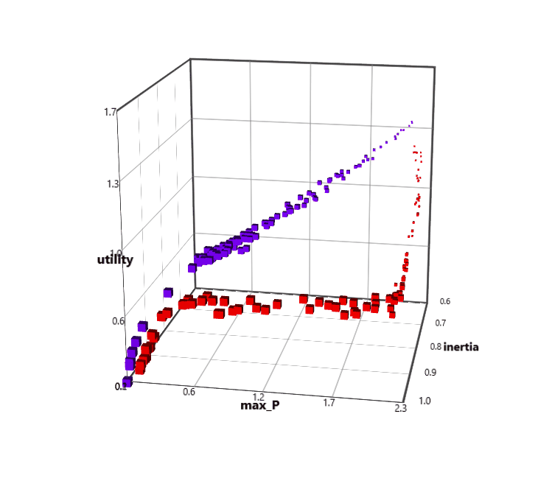
Why is this important?
The results indicate that the DPS strategy was able to find more dominant solutions than the intertemporal strategy.
Multiple DPS solutions outperform intertemporal solutions in every objective.
In other words, DPS is able to find solutions that achieve higher economic benefits at lower P concentrations and higher reliability and inertia.

Slide 31
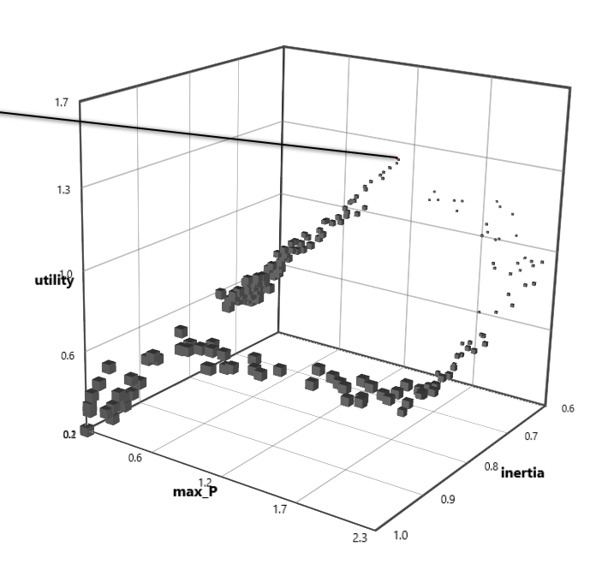
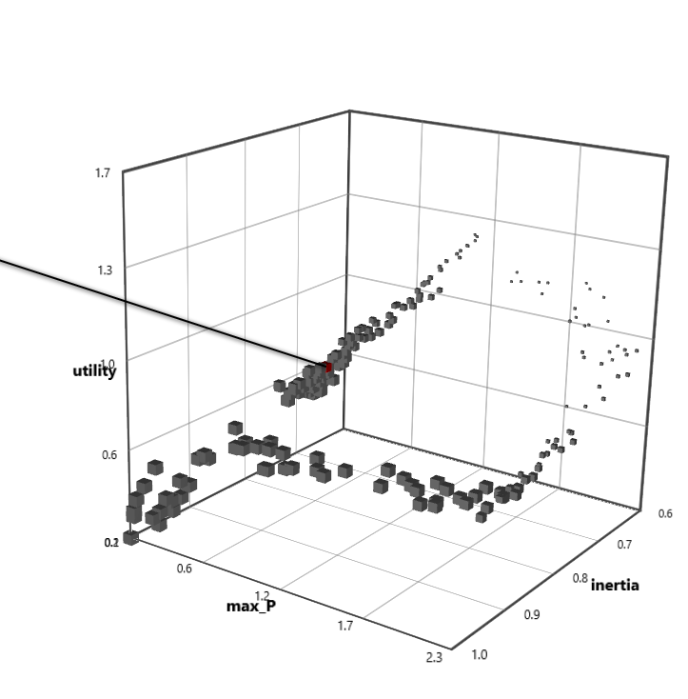
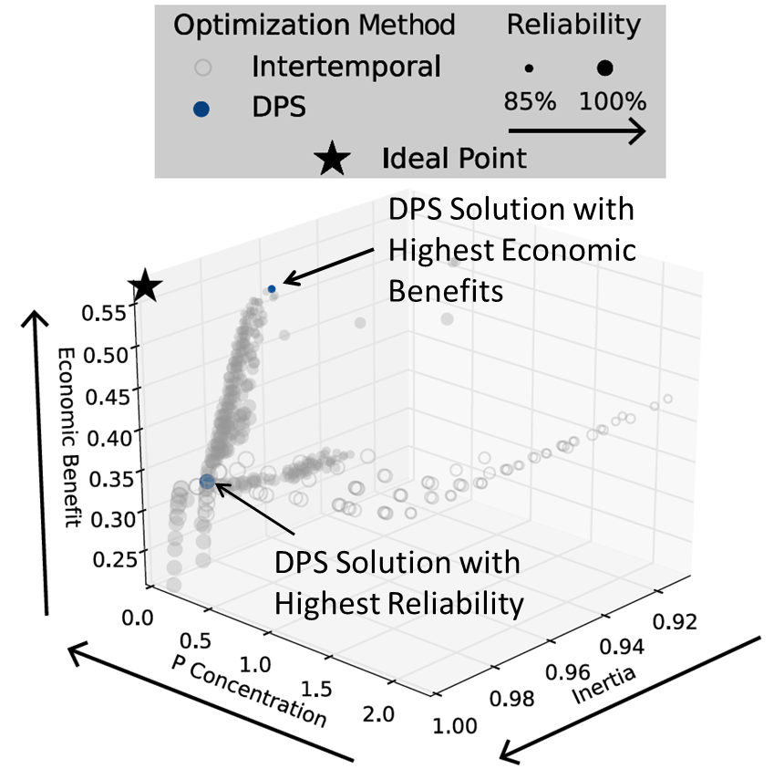
Investigating specific solutions
DPS solution with highest economic benefits
DPS solution with highest reliability

Slide 32
Note:
Doing the analysis in this manner, keeps all solutions found between the two strategies (100 for each if using NSGAII). Some of these solutions might be dominated by solutions found using the other strategy.
We can sort all solutions for non-dominance and generate an overall set of non-dominated solutions.
To do so one can use pareto.py. Save in the same directory and run:
python pareto.py ./*output_objectives.csv -o 1-4 -e 0.01 0.01 0.001 0.001 --header 1 --output overallreference.csv --delimiter="," --comment="#" --contribution --maximize 1 3-4

Slide 33
Note:
This will produce an overall reference set with 153 solutions, 88 of which came from the DPS strategy and 65 from the intertemporal.
To load and continue the analysis with this set run:
colnames = ['sol_no']+list(dps_model.responses.keys())+['strategy']
merged_sorted = load('overallreference.csv', names=colnames)[1]

Slide 34
Robustness Assessment
Evaluated the performance of Intertemporal and DPS solutions on 1,000 Latin hypercube samples of parameter values, or “States of the World” (SOWs):
Parameter | Base Value | Minimum | Maximum
b | 0.42 | 0.1 | 0.45
q | 2 | 2.0 | 4.5
µ | 0.03 | 0.01 | 0.05
σ | √10⁻⁵ ≈ 0.003 | 0.001 | 0.005
X₀ | 0 | 0 | 0.3
δ | 0.98 | 0.93 | 0.99

Slide 35
Robustness Assessment
Evaluated the performance of Intertemporal and DPS solutions on 1,000 Latin hypercube samples of parameter values, or “States of the World” (SOWs):
For each point in the Pareto set, we find the fraction of the 1,000 SOWs in which:
Average Economic Benefits > 0.2 AND Average Reliability > 95%
Parameter | Base Value | Minimum | Maximum
b | 0.42 | 0.1 | 0.45
q | 2 | 2.0 | 4.5
µ | 0.03 | 0.01 | 0.05
σ | √10⁻⁵ ≈ 0.003 | 0.001 | 0.005
X₀ | 0 | 0 | 0.3
δ | 0.98 | 0.93 | 0.99

Slide 36
Assessing robustness with Rhodium
We have already defined our exogenous uncertainties:
model.uncertainties = [UniformUncertainty("b", 0.1, 0.45),
UniformUncertainty("q", 2.0, 4.5),
UniformUncertainty("mean", 0.01, 0.05),
UniformUncertainty("stdev", 0.001, 0.005),
UniformUncertainty("delta", 0.93, 0.99)]
We now need to sample them:
SOWs = sample_lhs(model, 1000)
And reaevalute all identified solutions under all the sampled SOWs:
reevaluation = [evaluate(model, update(SOWs, policy)) for policy in output]
reevaluation_dps = [evaluate(dps_model, update(SOWs, policy)) for policy in dps_output]
This will take a while to run

Slide 37
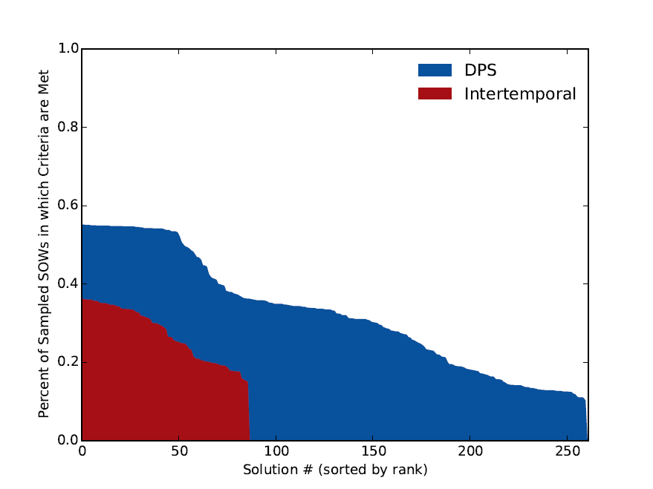
Average Reliability > 95% and Average Economic Benefits > 0.2

Slide 38
What’s driving these failures?

Slide 39
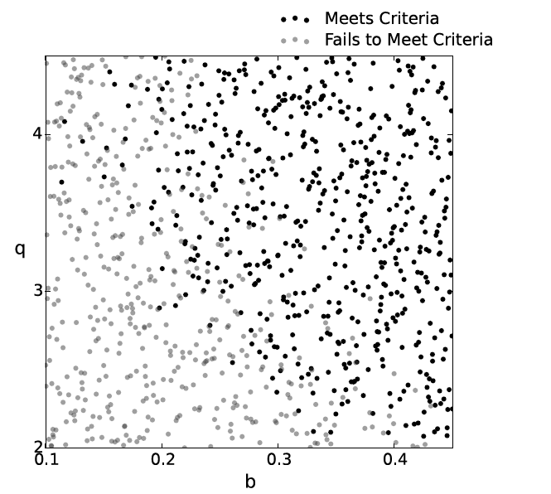
Let’s look at the most robust DPS solution

Slide 40
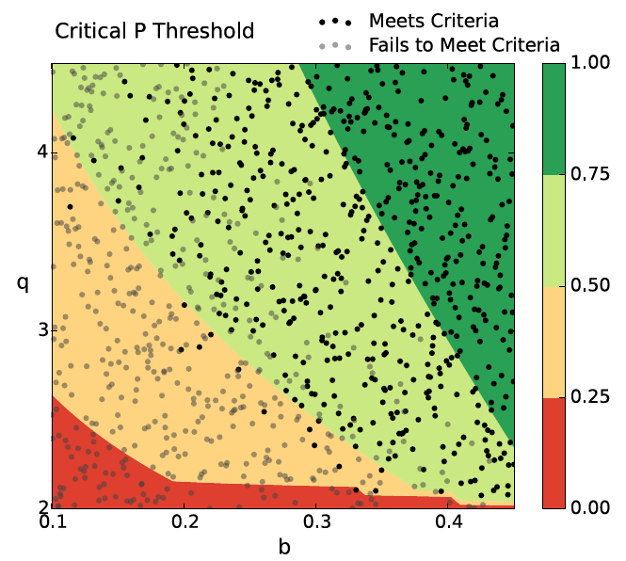
Let’s look at the most robust DPS solution

Slide 41
Let’s look at the most robust DPS solution
Optimized to a world in which critical P threshold = 0.54, approximate failure threshold

Slide 42
Let’s look at the most robust DPS solution
Including information on estimated b and q into the DPS policy (and updating this through endogenous learning) could improve robustness
Optimized to a world in which critical P threshold = 0.54, approximate failure threshold

Slide 43
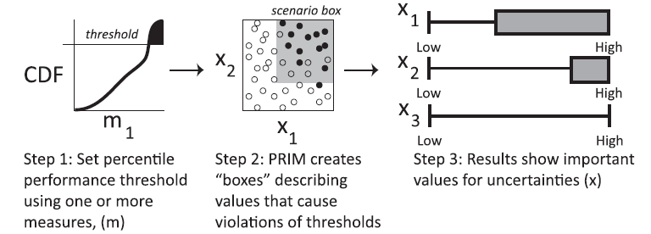
Methods for scenario discovery
Patient Rule Induction Method (PRIM)
Kasprzyk et al. 2013 Env. Mod. Soft.

Slide 44
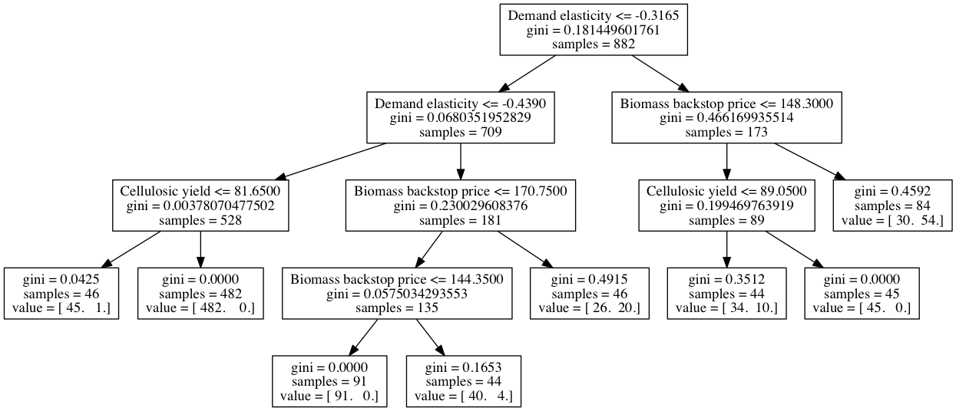
Methods for scenario discovery
Classification and Regression Trees (CART)

Slide 45
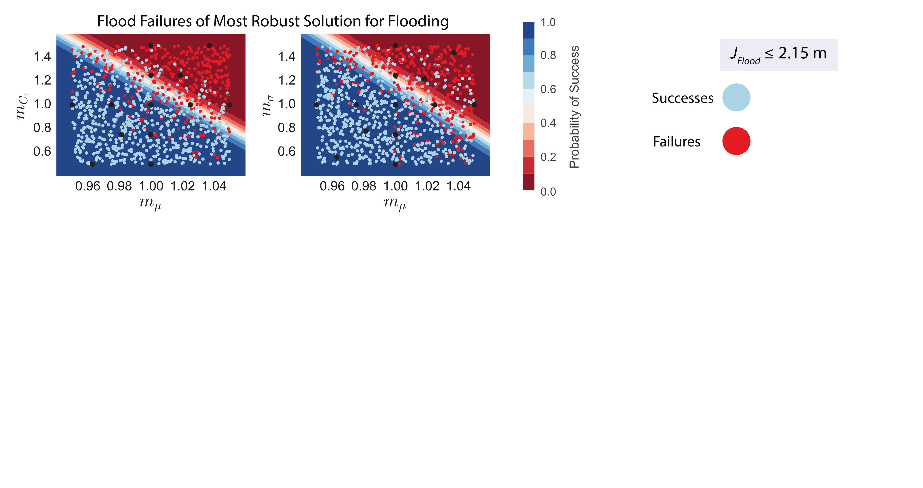
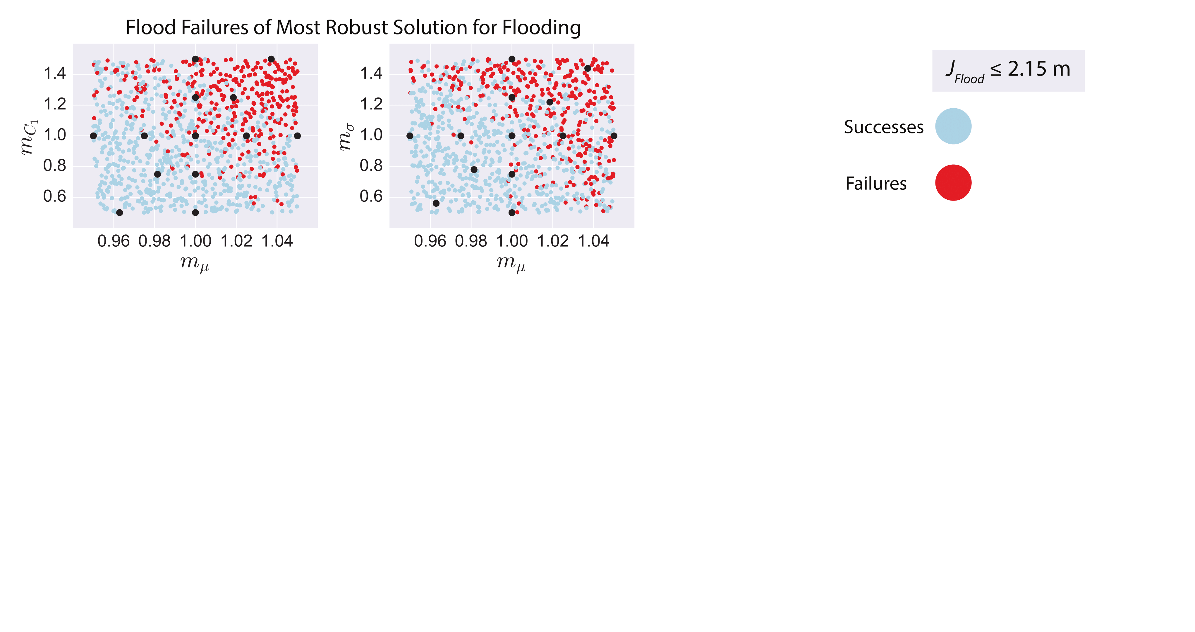

Methods for scenario discovery
Logistic Regression

Slide 46


Slide 47
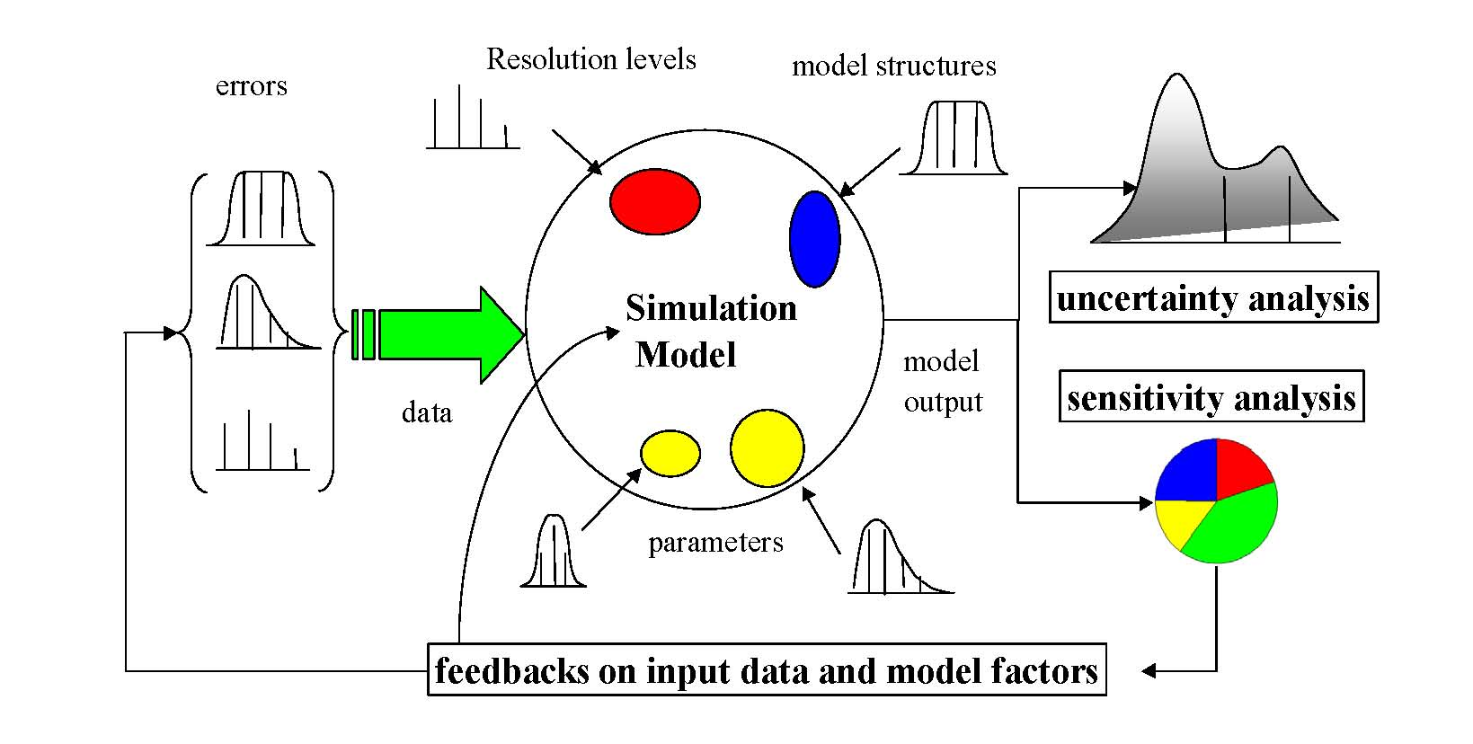
Relationship between Uncertainty & Sensitivity Analysis
[Andrea Saltelli (2009), http://sensitivity-analysis.jrc.ec.europa.eu]

Slide 48
What is SA?
“
Sensitivity analysis: The study of how the uncertainty in the output of a model (numerical or otherwise) can be apportioned to different sources of uncertainty in the model input.
”
(Saltelli, A., 2002, Sensitivity Analysis for Importance Assessment, Risk Analysis, 22 (3), 1-12)

Slide 49
What is SA?
“
Sensitivity analysis: The study of how the uncertainty in the output of a model (numerical or otherwise) can be apportioned to different sources of uncertainty in the model input.
”
(Saltelli, A., 2002, Sensitivity Analysis for Importance Assessment, Risk Analysis, 22 (3), 1-12)

Slide 50
What is SA?
“
Sensitivity analysis: The study of how the uncertainty in the output of a model (numerical or otherwise) can be apportioned to different sources of uncertainty in the model input.
”
(Saltelli, A., 2002, Sensitivity Analysis for Importance Assessment, Risk Analysis, 22 (3), 1-12)

Slide 51
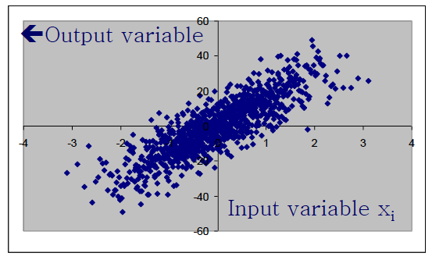
Defining a Global SA metric
(Example from: Saltelli, A., 2017)

Slide 52
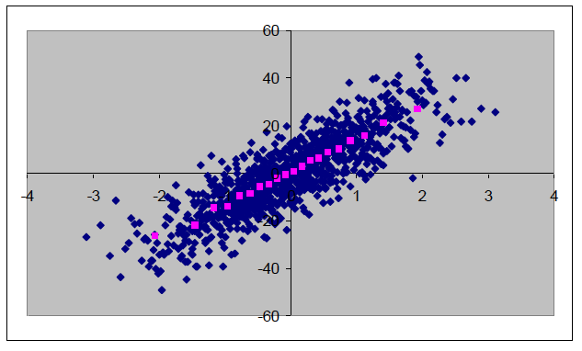
Defining a Global SA metric
(Example from: Saltelli, A., 2017)

Slide 53
Defining a Global SA metric
Bin Points along x-axis and take average of bin
(Example from: Saltelli, A., 2017)

Slide 54
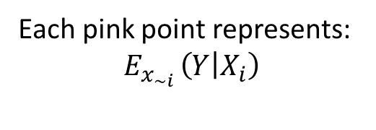
Defining a Global SA metric
Bin Points along x-axis and take average of bin
Each pink point represents:
$$E_{x_{\sim i }}\left(Y | X_{i}\right)$$
(Example from: Saltelli, A., 2017)

Slide 55
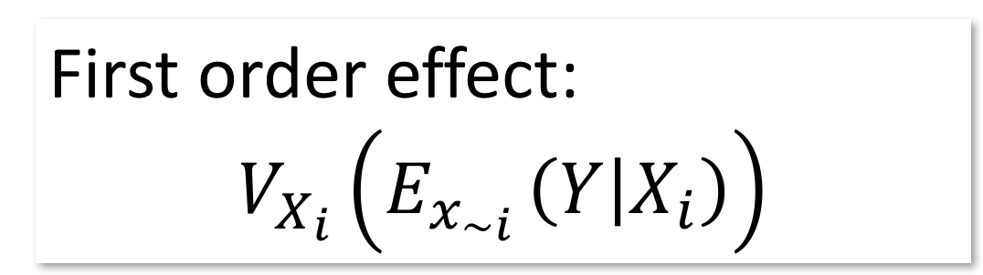
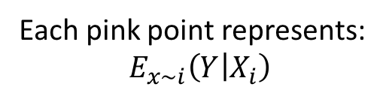
Defining a Global SA metric
First order effect:
$$V_{X_{i}}\left(E_{x_{\sim i }}\left(Y | X_{i}\right)\right)$$
Bin Points along x-axis and take average of bin
Each pink point represents:
$$E_{x\sim i}\left(Y | X_{i}\right)$$
(Example from: Saltelli, A., 2017)

Slide 56
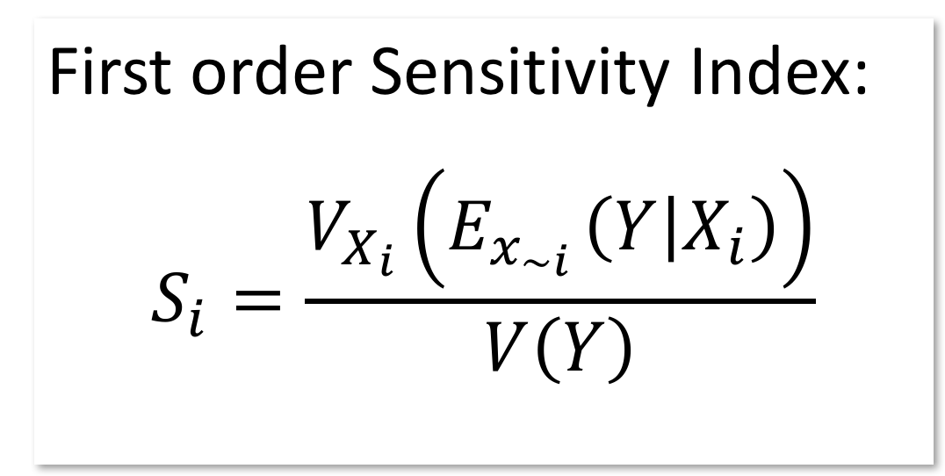
Defining a Global SA metric
First order Sensitivity Index:
$$S_{i}=\frac{V_{X_{i}}\left(E_{x_{\sim i }}\left(Y | X_{i}\right)\right)}{V\left(Y\right)}$$
Bin Points along x-axis and take average of bin
Each pink point represents:
$$E_{x\sim i}\left(Y | X_{i}\right)$$
(Example from: Saltelli, A., 2017)

Slide 57
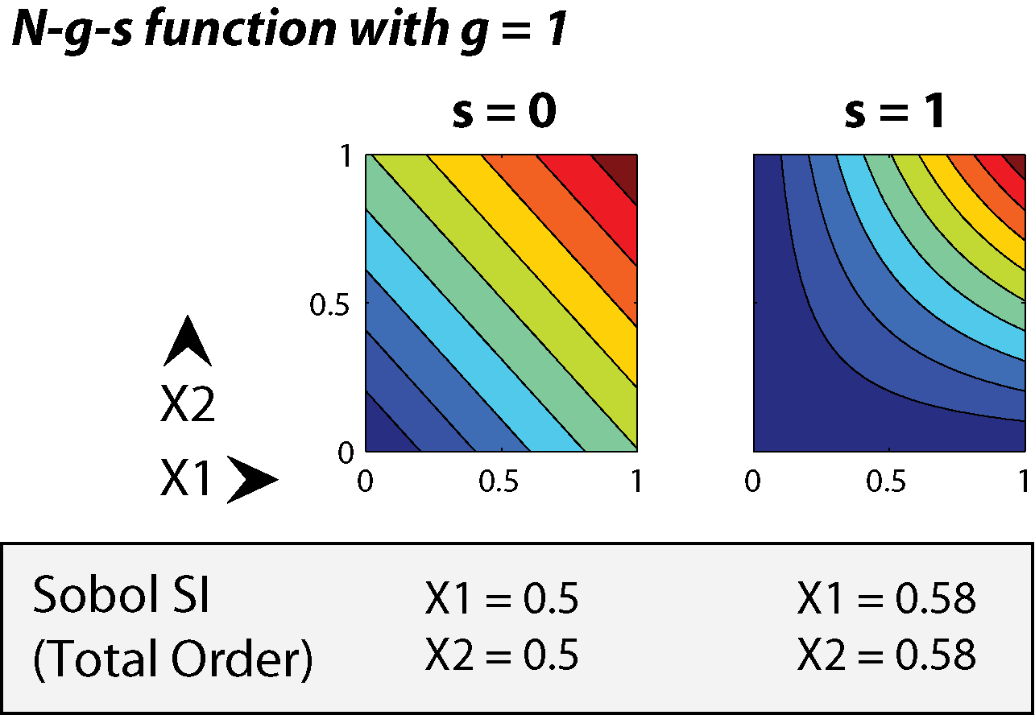
What about interactions?
Y
0
0.5
1

Slide 58
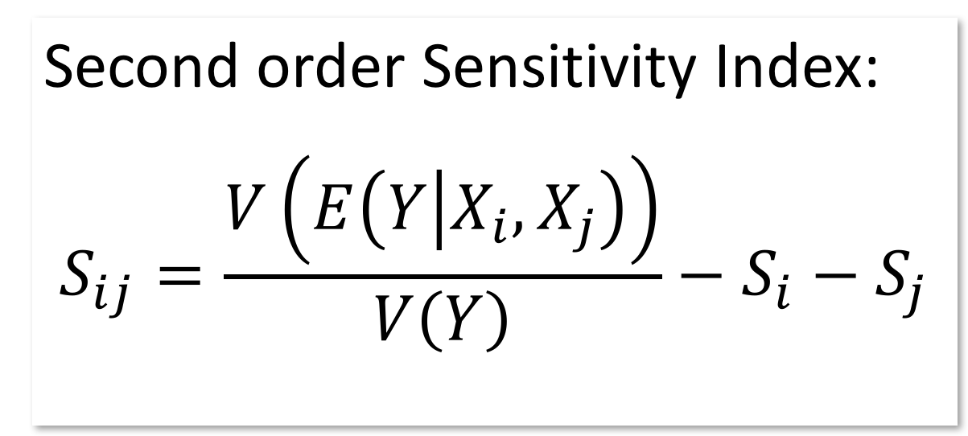
What about interactions?
Second order Sensitivity Index:
$$S_{ij}=\frac{V\left(E\left(Y | X_{i},X_{j}\right)\right)}{V\left(Y\right)}−S_{i}−S_{j}$$
Y
0
0.5
1

Slide 59
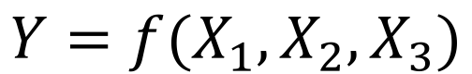
Total Order Sensitivity
$$Y=f(X_{1}, X_{2},X_{3})$$

Slide 60
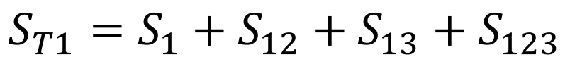
Total Order Sensitivity
$$Y=f(X_{1}, X_{2},X_{3})$$
$$S_{T1}=S_{1}+S_{12}+S_{13}+S_{123}$$

Slide 61
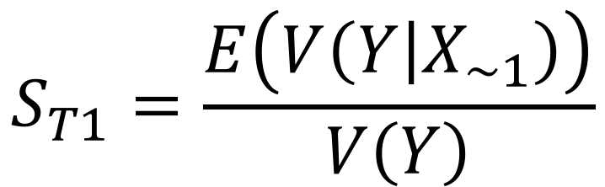
Total Order Sensitivity
$$Y=f(X_{1}, X_{2},X_{3})$$
$$S_{T1}=S_{1}+S_{12}+S_{13}+S_{123}$$
$$S_{T1}=\frac{E\left(V\left(Y | X_{\sim 1}\right)\right)}{V\left(Y\right)}$$

Slide 62
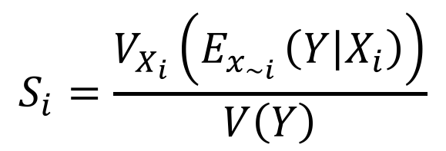
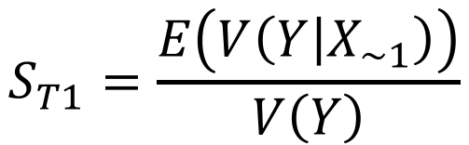
Drawing Conclusions from Sensitivity
First Order:
$$S_{i}=\frac{V_{X_{i}}\left(E_{x_{\sim i }}\left(Y | X_{i}\right)\right)}{V\left(Y\right)}$$
Total Order:
$$S_{T1}=\frac{E\left(V\left(Y | X_{\sim 1}\right)\right)}{V\left(Y\right)}$$

Slide 63
Drawing Conclusions from Sensitivity
First Order:
$$S_{i}=\frac{V_{X_{i}}\left(E_{x_{\sim i }}\left(Y | X_{i}\right)\right)}{V\left(Y\right)}$$
Factor
Prioritization
Total Order:
$$S_{T1}=\frac{E\left(V\left(Y | X_{\sim 1}\right)\right)}{V\left(Y\right)}$$

Slide 64
Drawing Conclusions from Sensitivity
First Order:
$$S_{i}=\frac{V_{X_{i}}\left(E_{x_{\sim i }}\left(Y | X_{i}\right)\right)}{V\left(Y\right)}$$
Factor
Prioritization
Total Order:
Factor
Screening
$$S_{T1}=\frac{E\left(V\left(Y | X_{\sim 1}\right)\right)}{V\left(Y\right)}$$

Slide 65
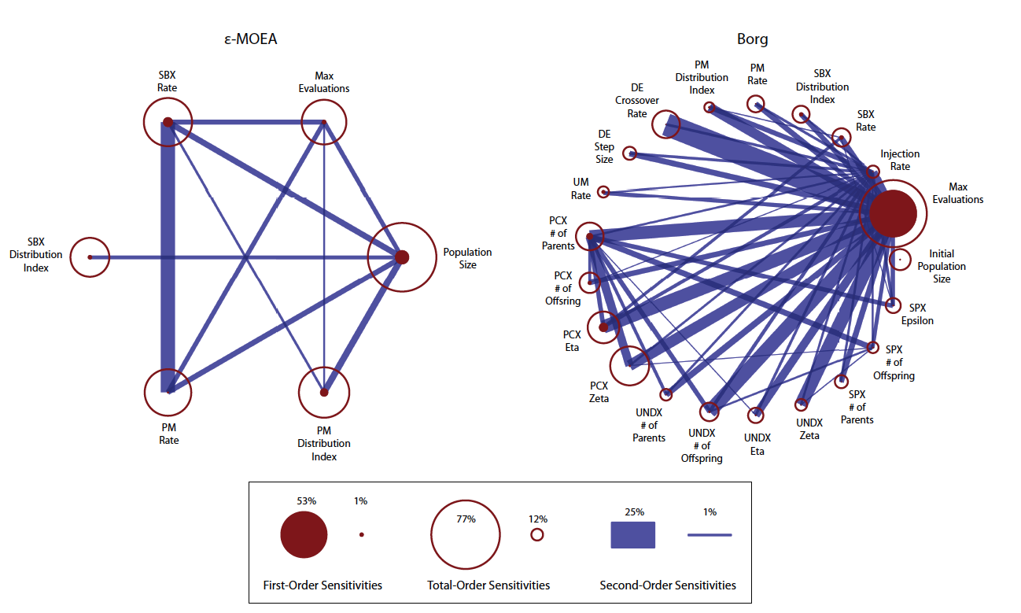
Visualizing Sensitivity

Slide 66
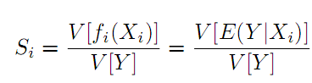
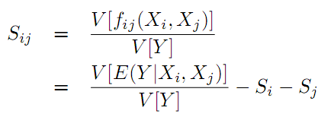
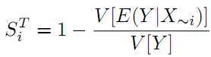
Sensitivity Analysis
(Sobol's Method)
i
j
k
Black Box
Function (f)
.
:
Y
n
First-Order Sensitivities:
Second-Order Sensitivities:
Total-Order Sensitivities:
Sum of all sensitivities involving input i

Slide 67
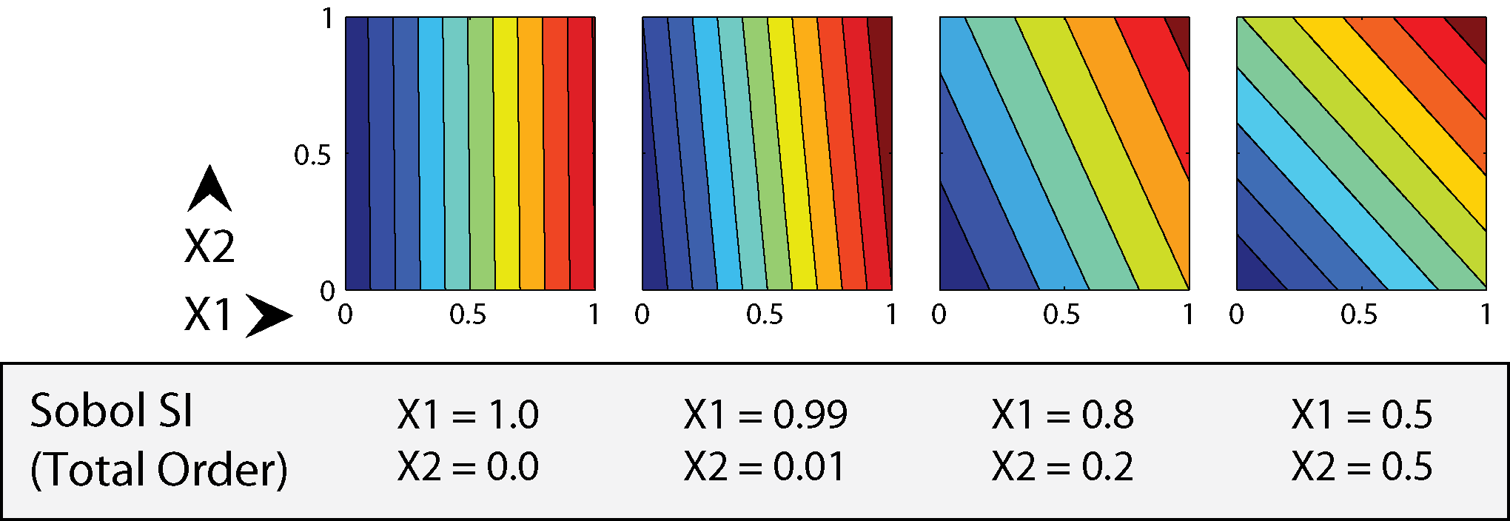
Example Sobol variance decomposition indices for linear (separable) functions

Slide 68
Example Sobol variance decomposition indices for separable and non-separable functions

Slide 69
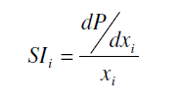
Local vs Global
Problem: Which point to use? Misses interactions!

Slide 70
Global SA: Sample throughout the space

Slide 71
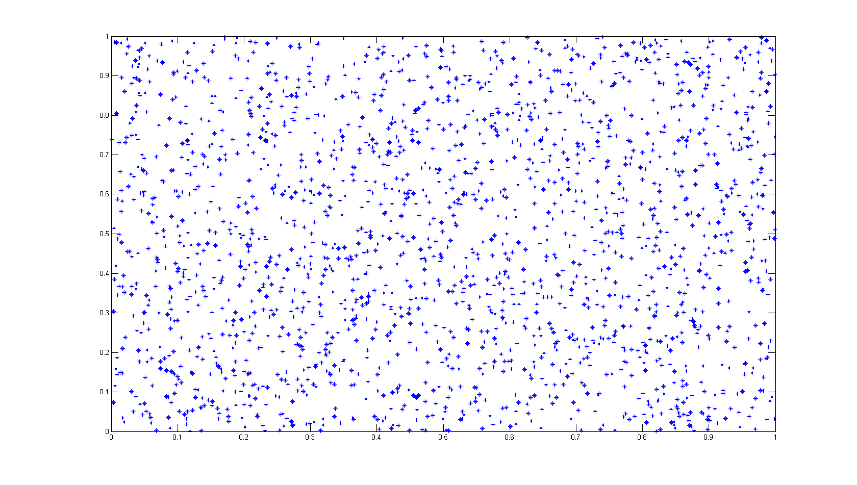
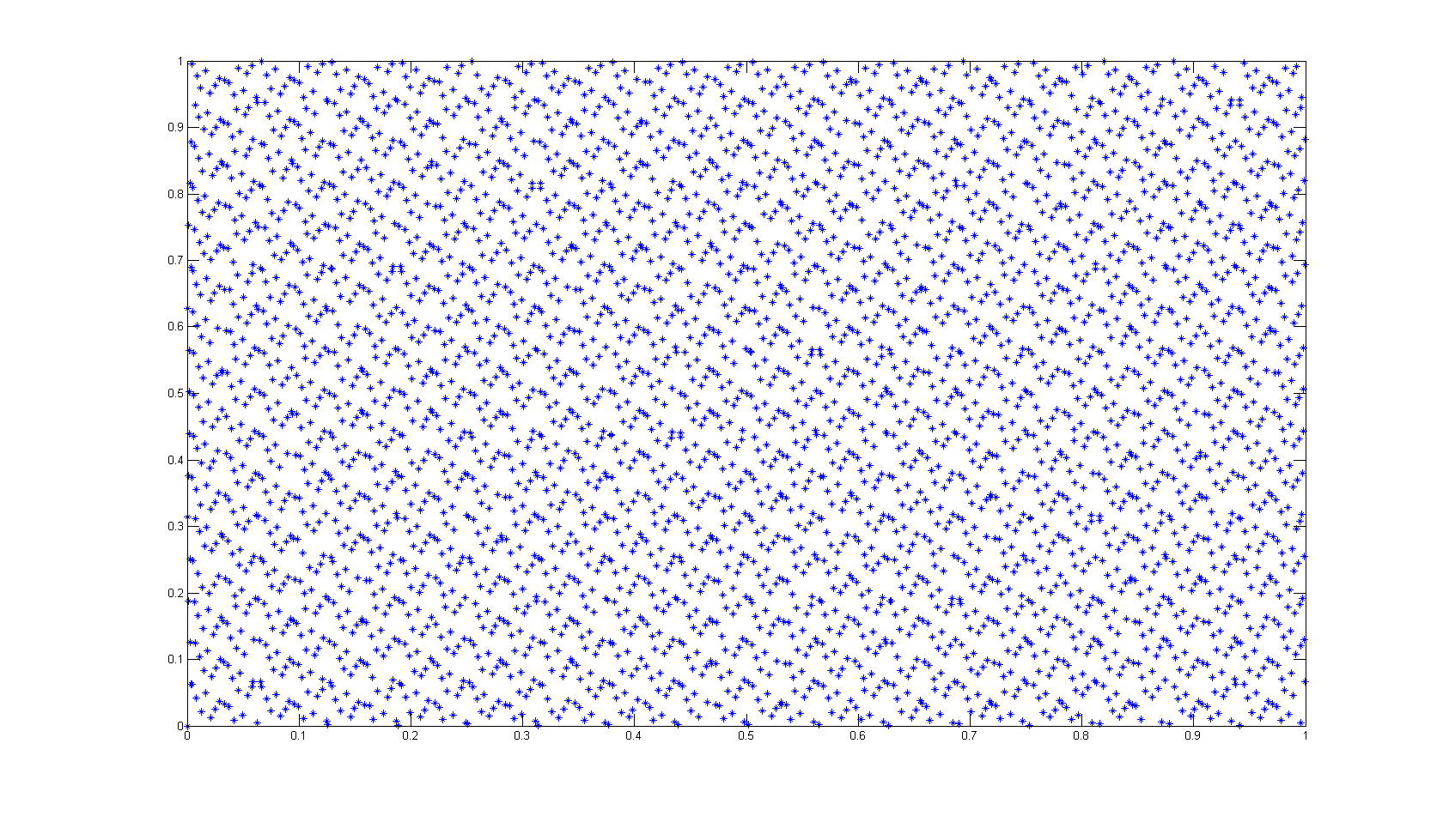
Improving Convergence
Random
Sobol' Sequence
Error Growth Rate

Slide 72
How can we compute the sensitivity indices efficiently?
Notes:
N(k+2) is considerably less than N² or 2^{N}. Note our code uses N(k+1) so the total sample size is 135,000. And ~1.5% of the results are filtered for non-compute/non-optimize.

Slide 73

How can we compute the sensitivity indices efficiently?
Make N(k+2) samples varying parameters ${(X}_{1},…,X_{k}$) within given bounds using quasi-random sampling (Sobol’ sequences) to minimize clumps and gaps in the samples.
Notes:
N(k+2) is considerably less than N² or 2^{N}. Note our code uses N(k+1) so the total sample size is 135,000. And ~1.5% of the results are filtered for non-compute/non-optimize.

Slide 74

How can we compute the sensitivity indices efficiently?
Make N(k+2) samples varying parameters ${(X}_{1},…,X_{k}$) within given bounds using quasi-random sampling (Sobol’ sequences) to minimize clumps and gaps in the samples.
Run the model for each parameter sample.
Notes:
N(k+2) is considerably less than N² or 2^{N}. Note our code uses N(k+1) so the total sample size is 135,000. And ~1.5% of the results are filtered for non-compute/non-optimize.

Slide 75

How can we compute the sensitivity indices efficiently?
Make N(k+2) samples varying parameters ${(X}_{1},…,X_{k}$) within given bounds using quasi-random sampling (Sobol’ sequences) to minimize clumps and gaps in the samples.
Run the model for each parameter sample.
Calculate the total variance: $V(Y)$
Notes:
N(k+2) is considerably less than N² or 2^{N}. Note our code uses N(k+1) so the total sample size is 135,000. And ~1.5% of the results are filtered for non-compute/non-optimize.

Slide 76

How can we compute the sensitivity indices efficiently?
Make N(k+2) samples varying parameters ${(X}_{1},…,X_{k}$) within given bounds using quasi-random sampling (Sobol’ sequences) to minimize clumps and gaps in the samples.
Run the model for each parameter sample.
Calculate the total variance: $V(Y)$
Make Monte Carlo estimates of the conditional variances : $V[E(Y|X_{i}$)] and $V[E(Y|X_{\sim i}$)]
Notes:
N(k+2) is considerably less than N² or 2^{N}. Note our code uses N(k+1) so the total sample size is 135,000. And ~1.5% of the results are filtered for non-compute/non-optimize.

Slide 77

How can we compute the sensitivity indices efficiently?
Make N(k+2) samples varying parameters ${(X}_{1},…,X_{k}$) within given bounds using quasi-random sampling (Sobol’ sequences) to minimize clumps and gaps in the samples.
Run the model for each parameter sample.
Calculate the total variance: $V(Y)$
Make Monte Carlo estimates of the conditional variances : $V[E(Y|X_{i}$)] and $V[E(Y|X_{\sim i}$)]
Calculate the sensitivity indices.
Notes:
N(k+2) is considerably less than N² or 2^{N}. Note our code uses N(k+1) so the total sample size is 135,000. And ~1.5% of the results are filtered for non-compute/non-optimize.

Slide 78
Sensitivity Analysis
(Sobol's Method)
i
j
k
Black Box
Function (f)
.
:
Y
n
First-Order Sensitivities:
Second-Order Sensitivities:
Total-Order Sensitivities:
Sum of all sensitivities involving input i

Slide 79

How can we compute the sensitivity indices efficiently?
Make N(k+2) samples varying parameters ${(X}_{1},…,X_{k}$) within given bounds using quasi-random sampling (Sobol’ sequences) to minimize clumps and gaps in the samples.
Run the model for each parameter sample.
Calculate the total variance: $V(Y)$
Make Monte Carlo estimates of the conditional variances : $V[E(Y|X_{i}$)] and $V[E(Y|X_{\sim i}$)]
Calculate the sensitivity indices.
Use bootstrapping to calculate uncertainty estimates for the sensitivity indices.
Notes:
N(k+2) is considerably less than N² or 2^{N}. Note our code uses N(k+1) so the total sample size is 135,000. And ~1.5% of the results are filtered for non-compute/non-optimize.

Slide 80

Sensitivity Analysis Library (SALib)
http://jdherman.github.io/SALib

Slide 81
Thanks! Questions?

